Slide 1


COZY
WAVE
Submitted to: Dr. Pranit Thakur
PG-10
Aditya Singh Aswal(2310990098)
Anuj Maurya(231991615)
Dhanur Rehlan(2310991647)

Slide 2

About the project
Cozy Wave enhances hospitality with innovation, focusing on guest comfort, sustainability, and technology.

Slide 3

Innovation?
Online booking platform built using Express and Node.js for secure and efficient reservations.
Implementation of five middlewares for request validation, error handling, authentication, logging, and data parsing.

Slide 4

Day to Day Application
Digital registration systems to streamline processes.
Online service bookings for accommodations of both hotels and resorts together
Sustainable practices such as energy conservation and waste reduction.

Slide 5
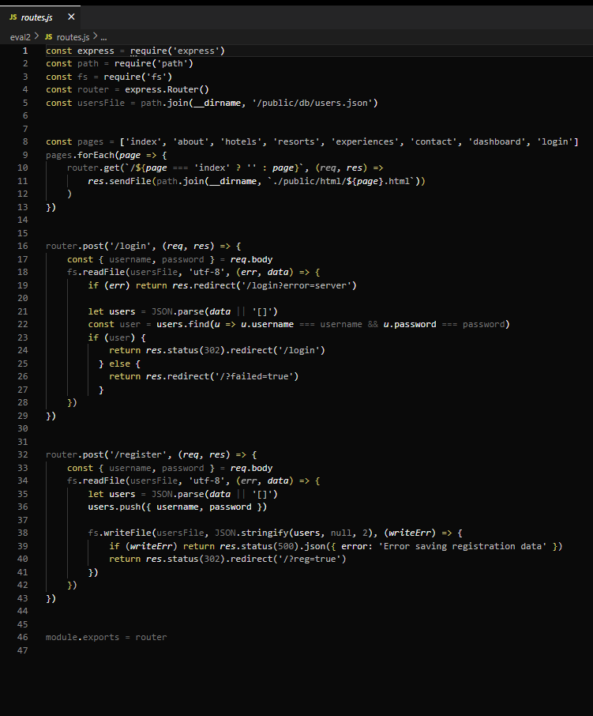
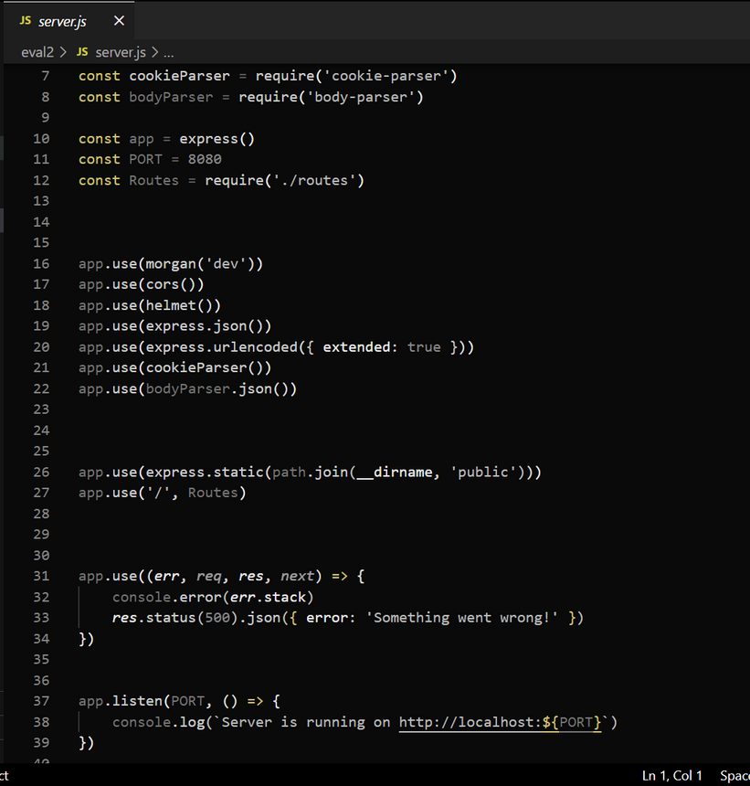
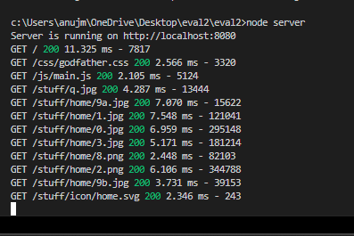


Snapshots

Slide 6

References
Class Notes
Express Js documentation:https://expressjs.com/
Node Js documention: https://nodejs.org/en/
Google drive link: https://shorturl.at/HsPMg

Slide 7

Thank
You

